Slide 1

UE19CS204 – Web Technologies Mini Project
Project Title -Event ticket selling
Section – E
Raeesa Tanseen PES2UG19CS310
Prachi Sengar PES2UG19CS285
Nithin Francis Alfred PES2UG19CS267
GITHUB Link - https://github.com/raeesatanseen/webtech

Slide 2
Abstract
Searching for tickets for different events is cumbersome and time consuming. Time and resources may not be available to collect information about the event and then book tickets before they are sold out. Our web application is an e-commerce platform where users can book their tickets for different events, without hassle.
We have made this fully functional website using MERN stack.
There is a Log in page for existing users and Register page for new users.
Home page lists all the upcoming events, which can be filtered based on the ticket price from low to high or high to low.
Filtering can also be done based on event category. On clicking on an event, its description and details are given.
Tickets for multiple desired events can be added to cart and their quantity can be changed.
Previously saved ticket recipients’ name and contact details are available or new ticket recipient details can be entered while booking tickets.
A booking summary is shown before confirming the payment mode on the booking page.
On confirming the order, the website routes to a ticket confirmation page.
After logging in, there is also an option to view the previous transactions and the status of orders for that user.

Slide 3
Technologies Used
FRONTEND DEPENDENCIES:
"react": "^16.9.0",
"react-dom": "^16.9.0",
"react-redux": "^7.1.1",
"react-router-dom": "^5.1.0",
"react-scripts": "3.1.2",
"redux": "^4.0.4",
"redux-thunk": "^2.3.0"
BACKEND DEPENDENCIES
"bcrypt": "^5.0.0",
"cors": "^2.8.5",
"express": "^4.17.1",
"jsonwebtoken": "^8.5.1",
"mongoose": "^5.7.1",
"nodemon": "^1.19.2“
Also used Postman to send api requests to the backend.

Slide 4
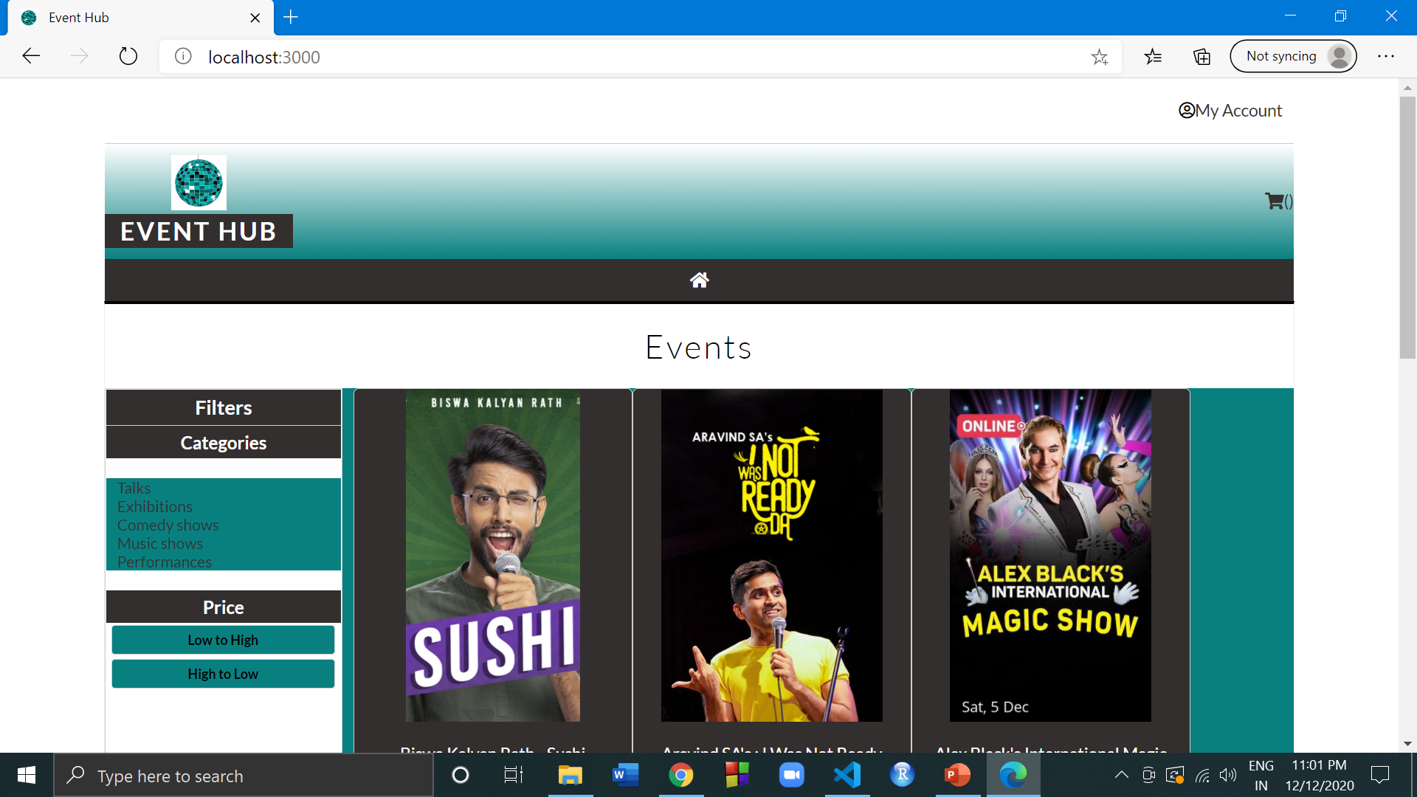
Website Home Page

Slide 5
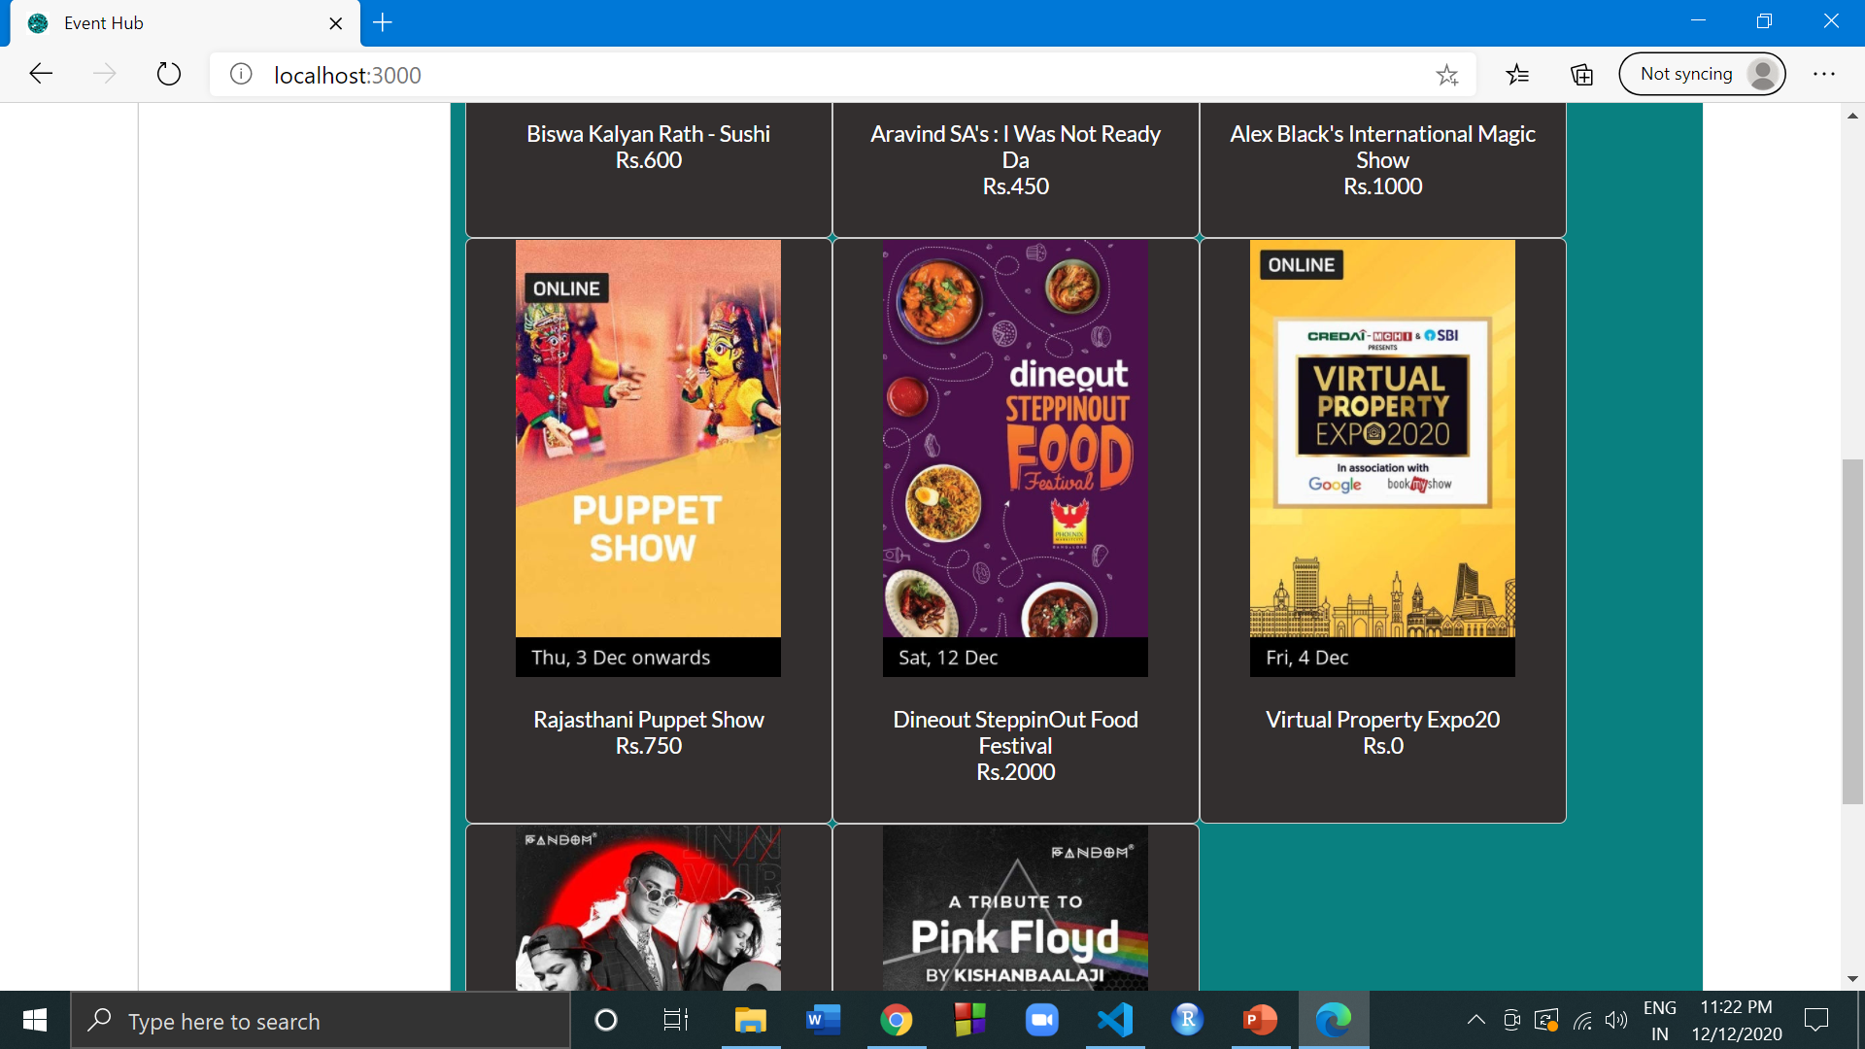
Home Page : Displaying all events

Slide 6
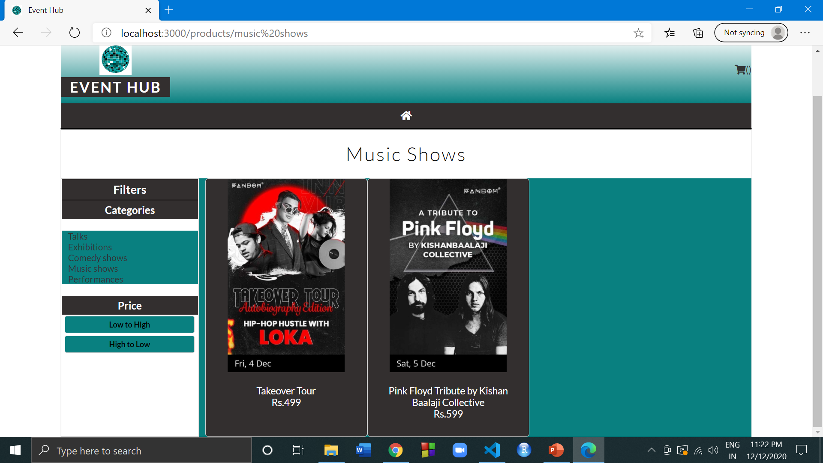
Filter based on category

Slide 7
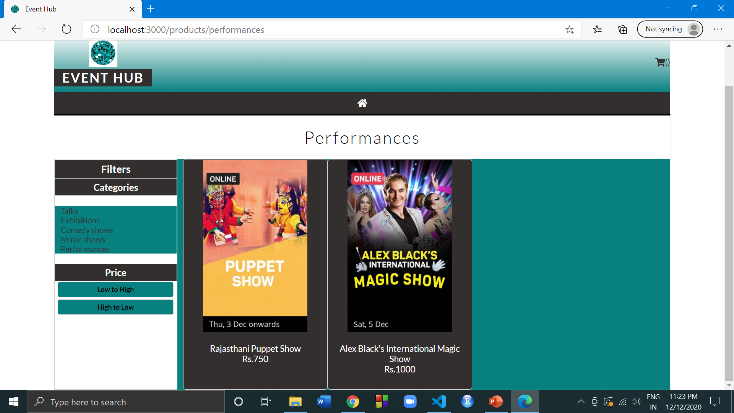
Filter based on price low to high

Slide 8
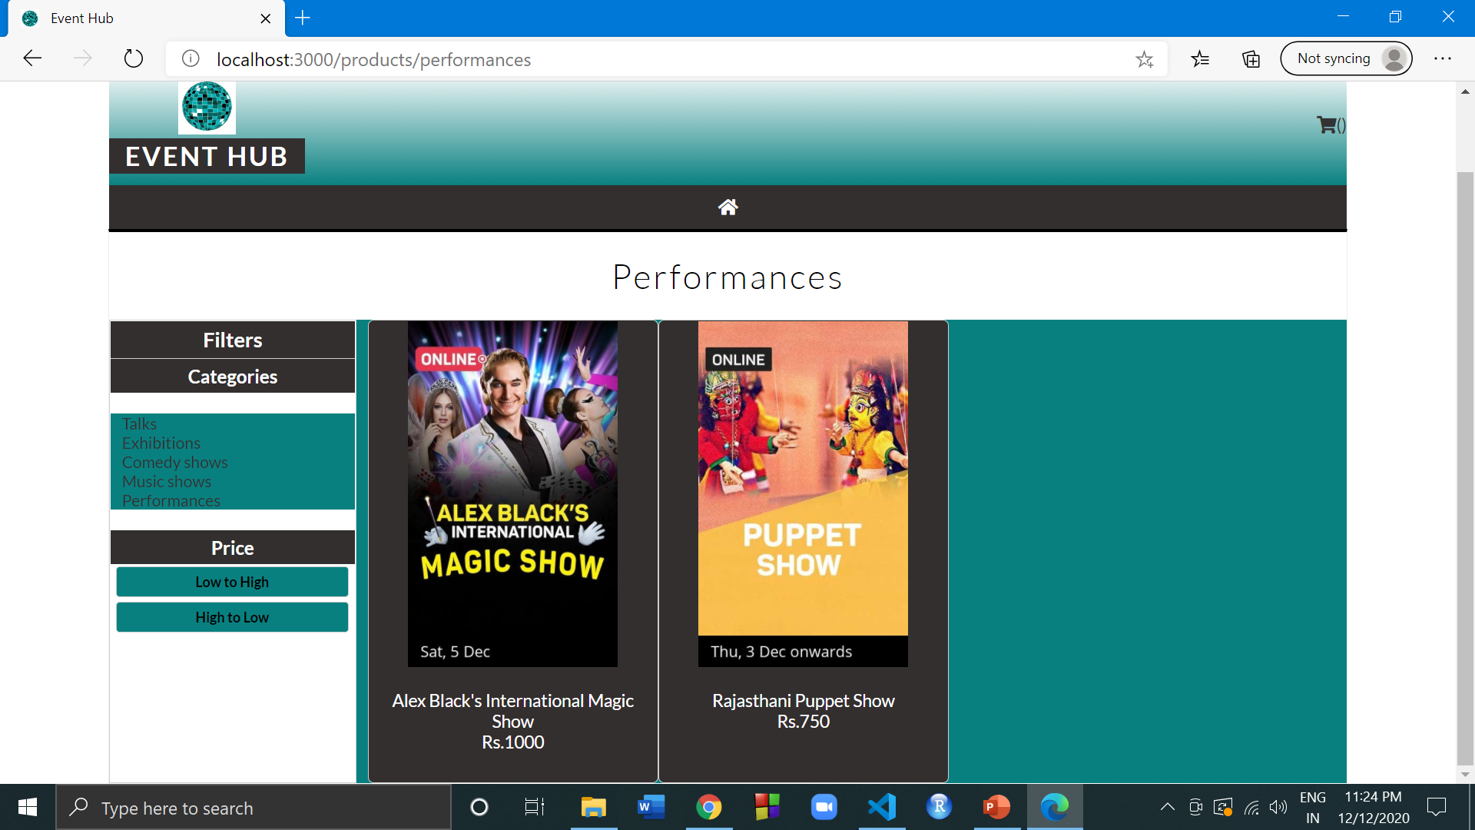
Filter based on price high to low

Slide 9
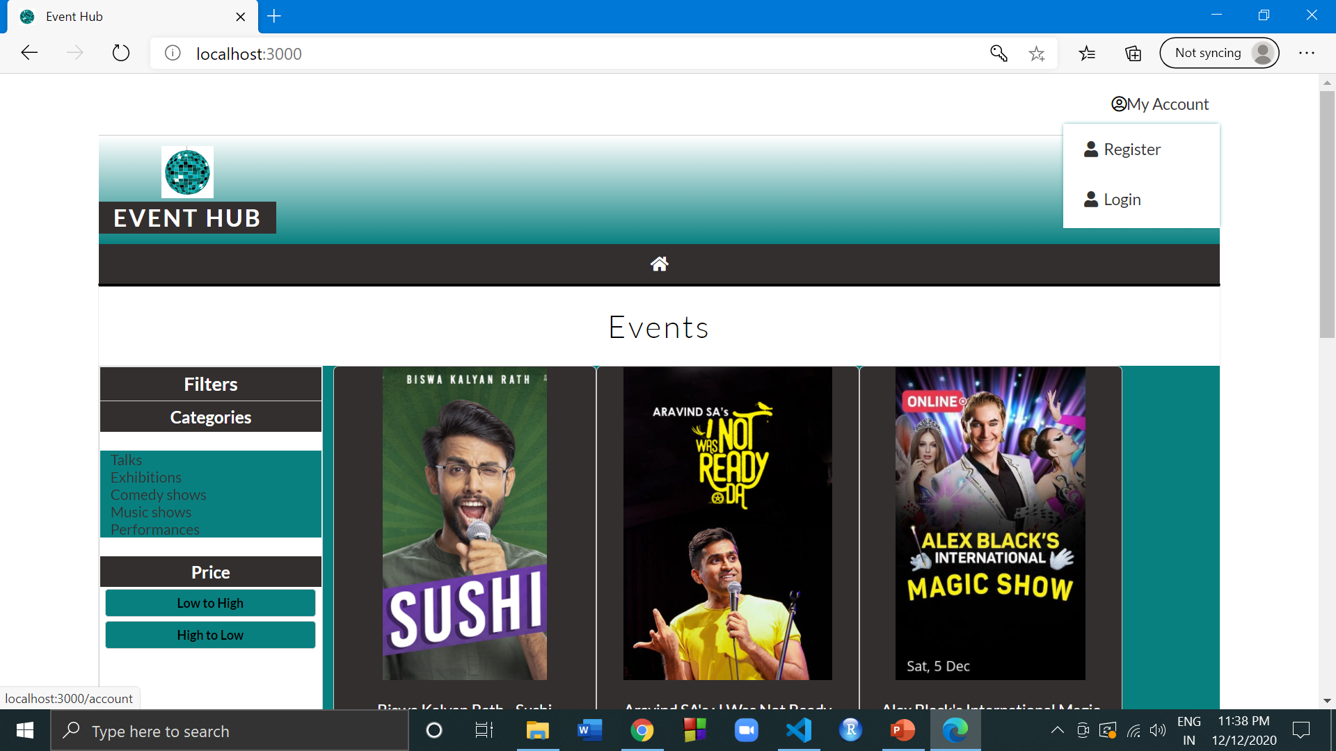
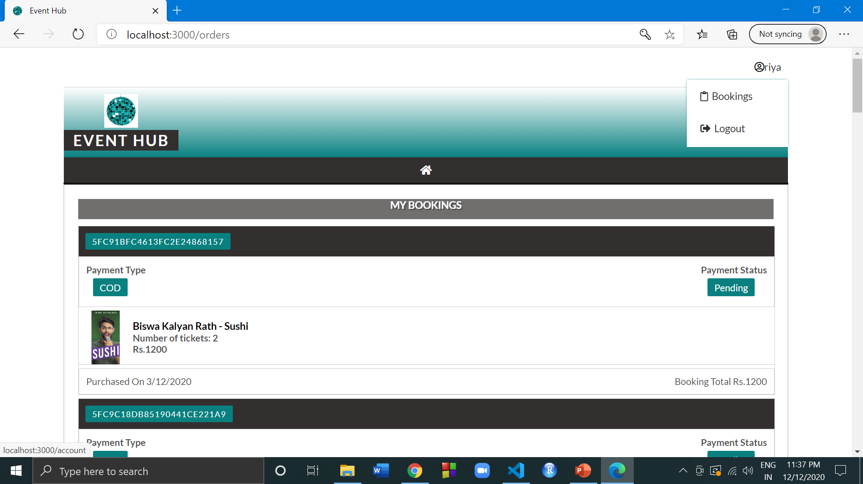
Drop down menu
Before logging in
After logging in

Slide 10
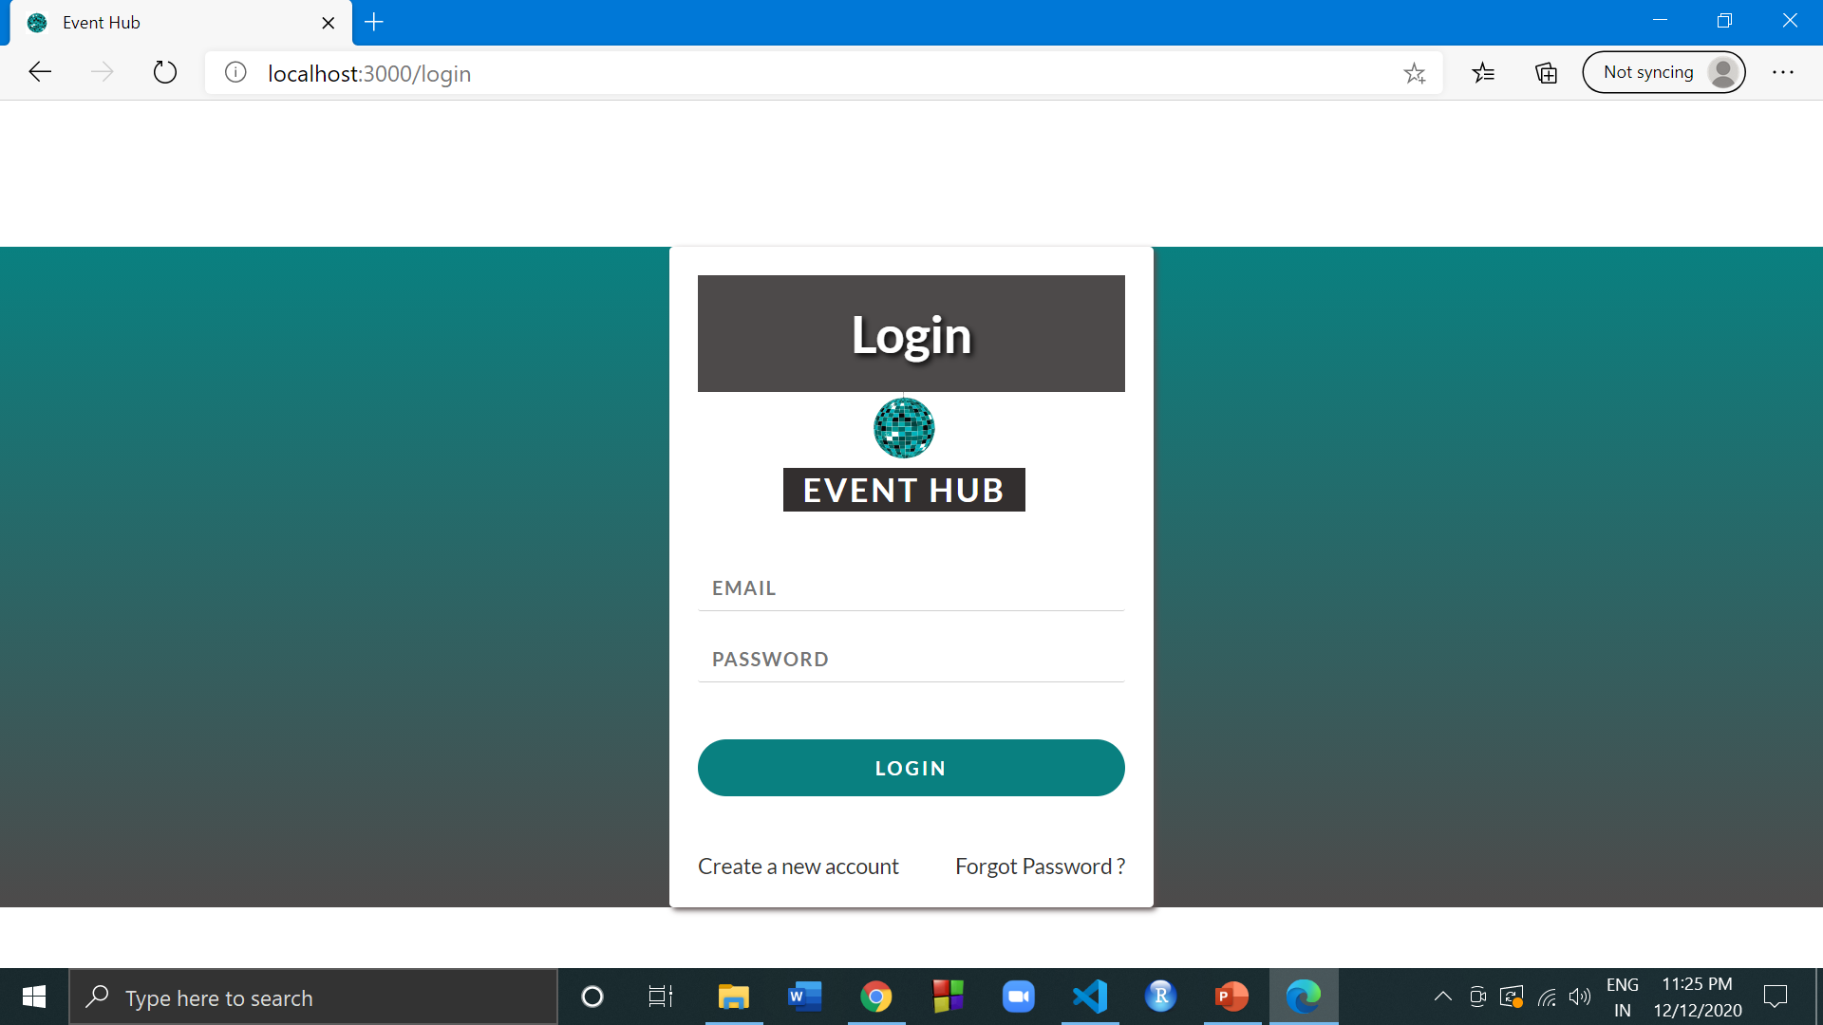
Log in page

Slide 11
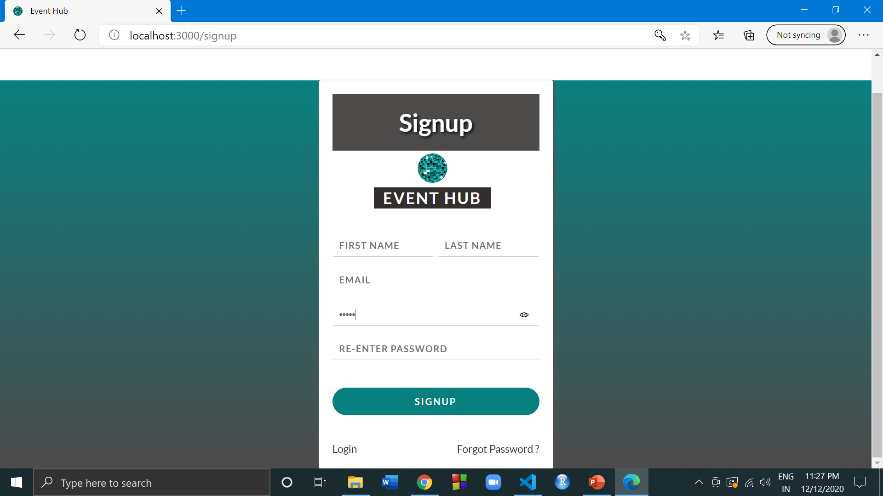
Sign up page

Slide 12
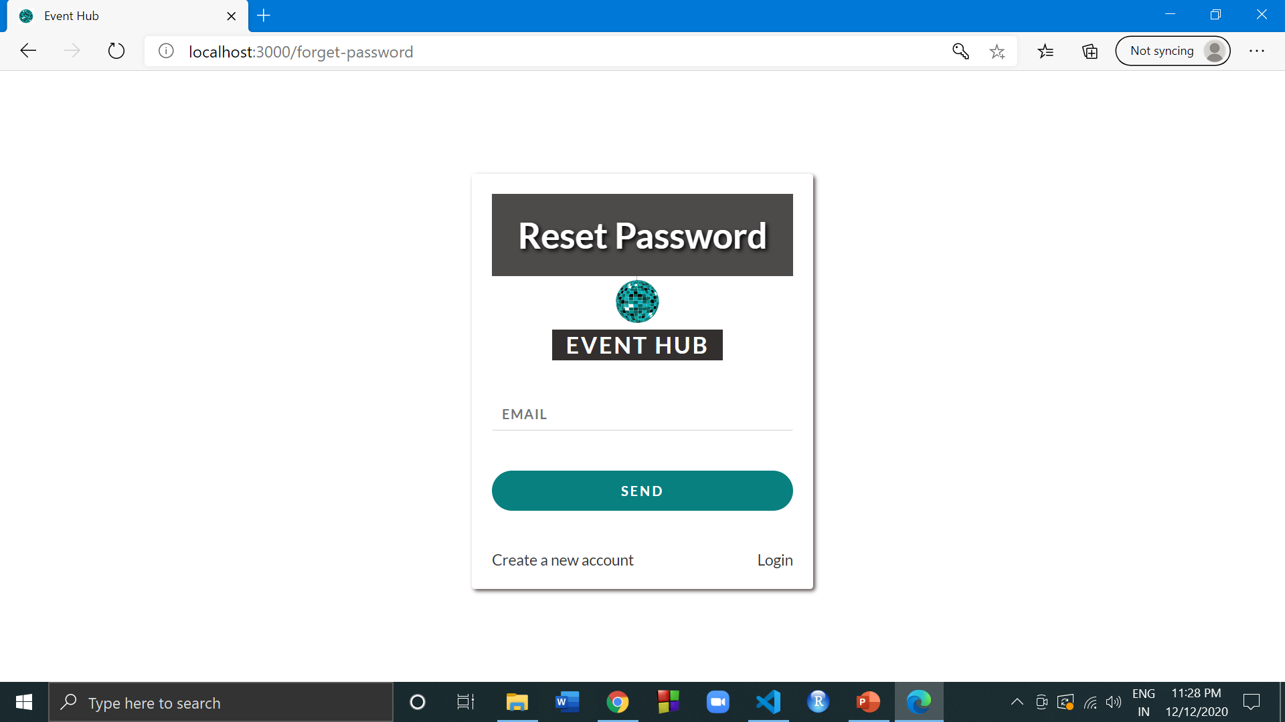
Forgot password page

Slide 13
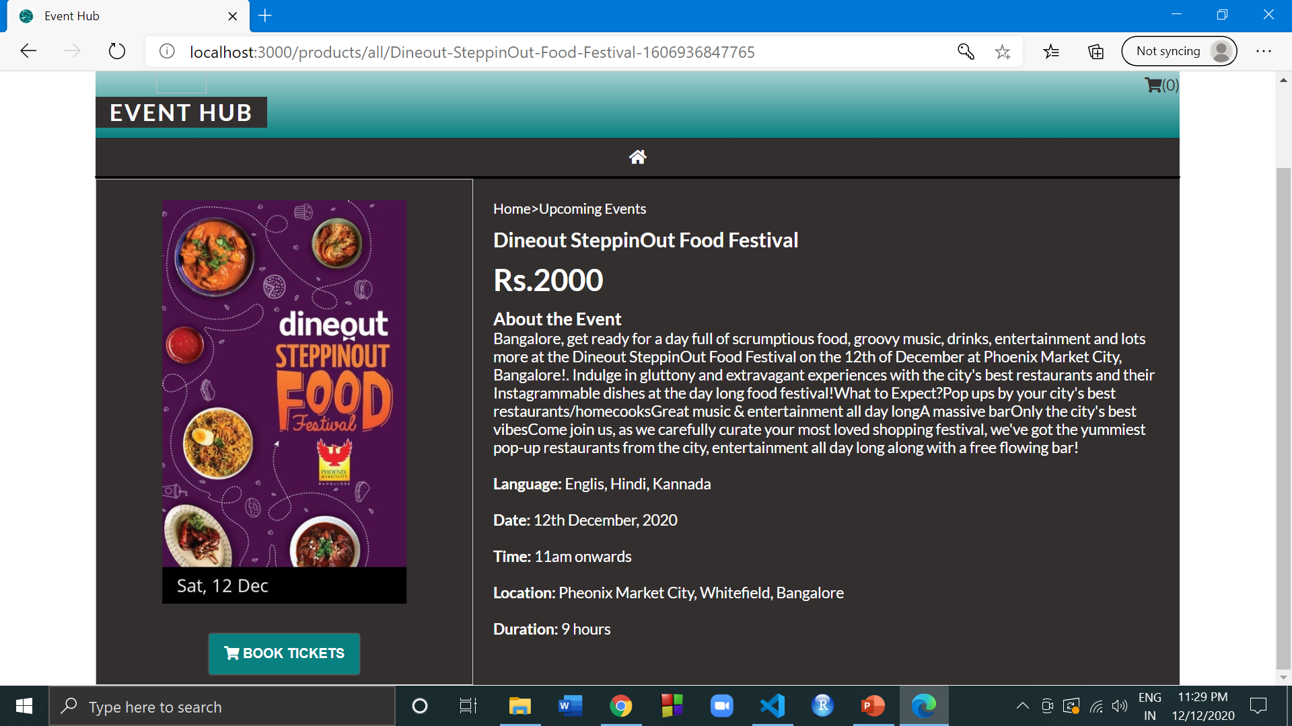
Event description page

Slide 14
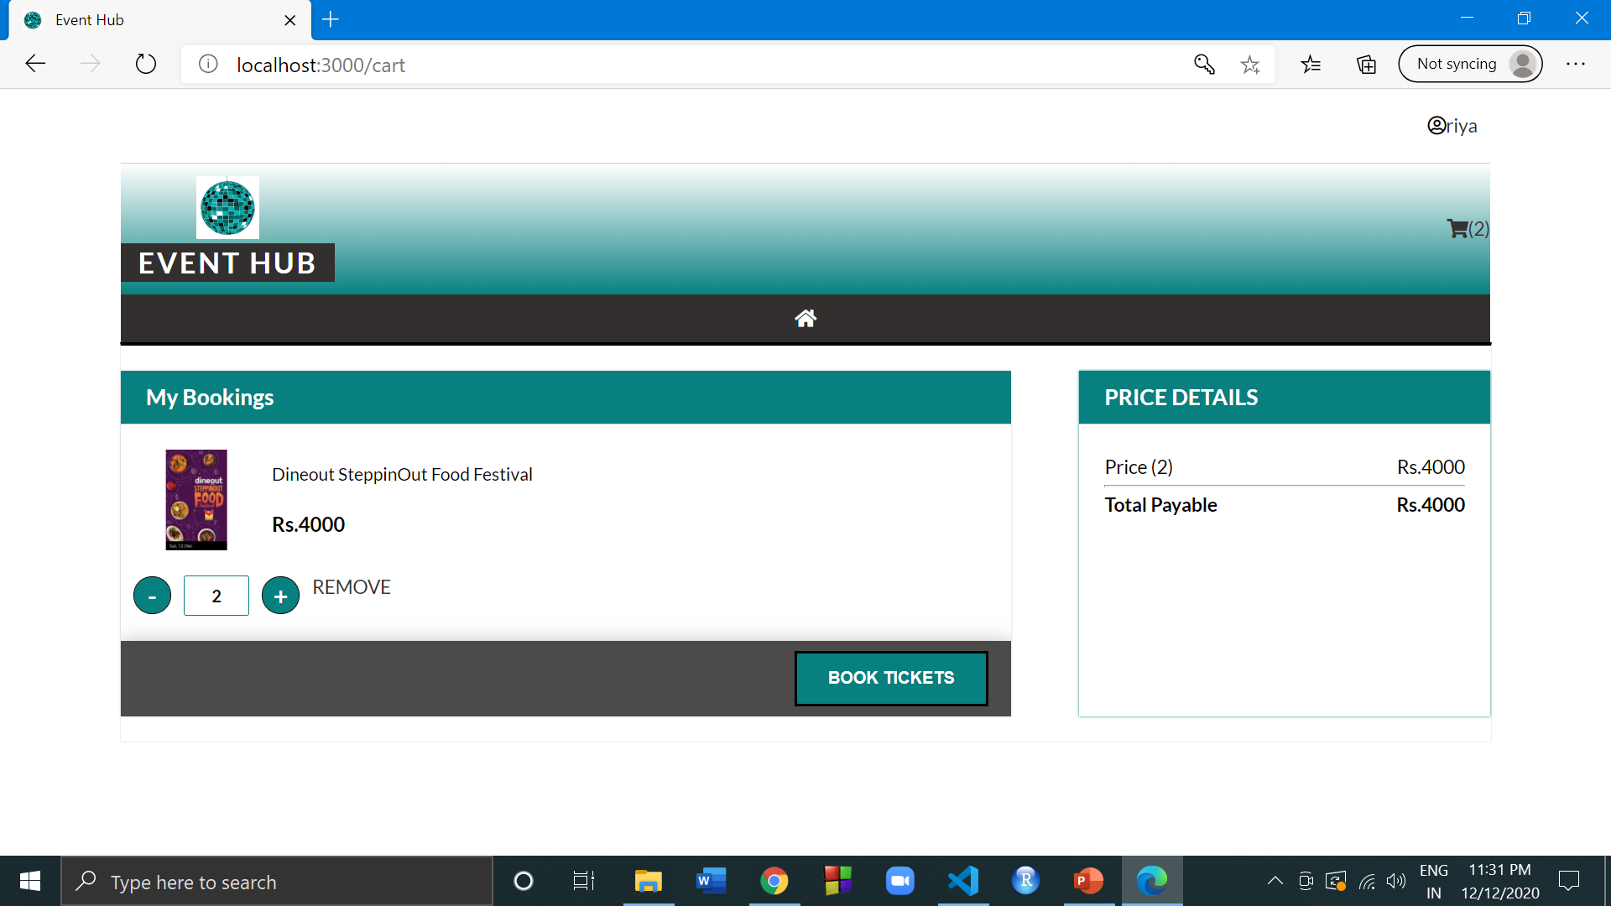
Cart and changing quantity

Slide 15
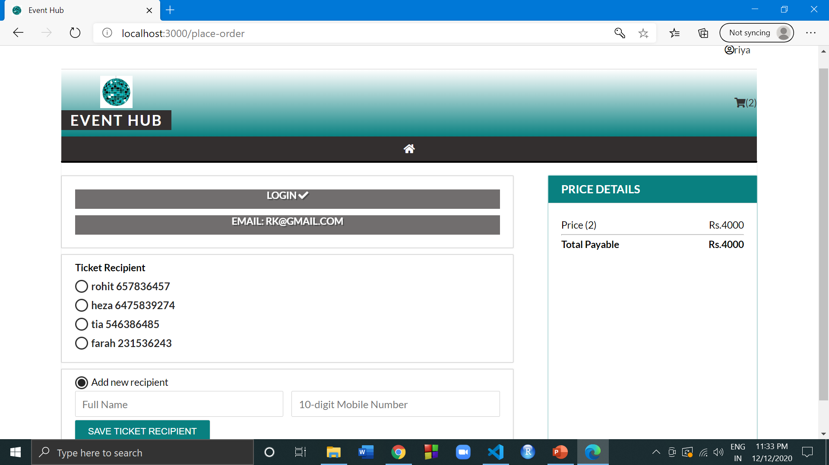
Entering order details

Slide 16
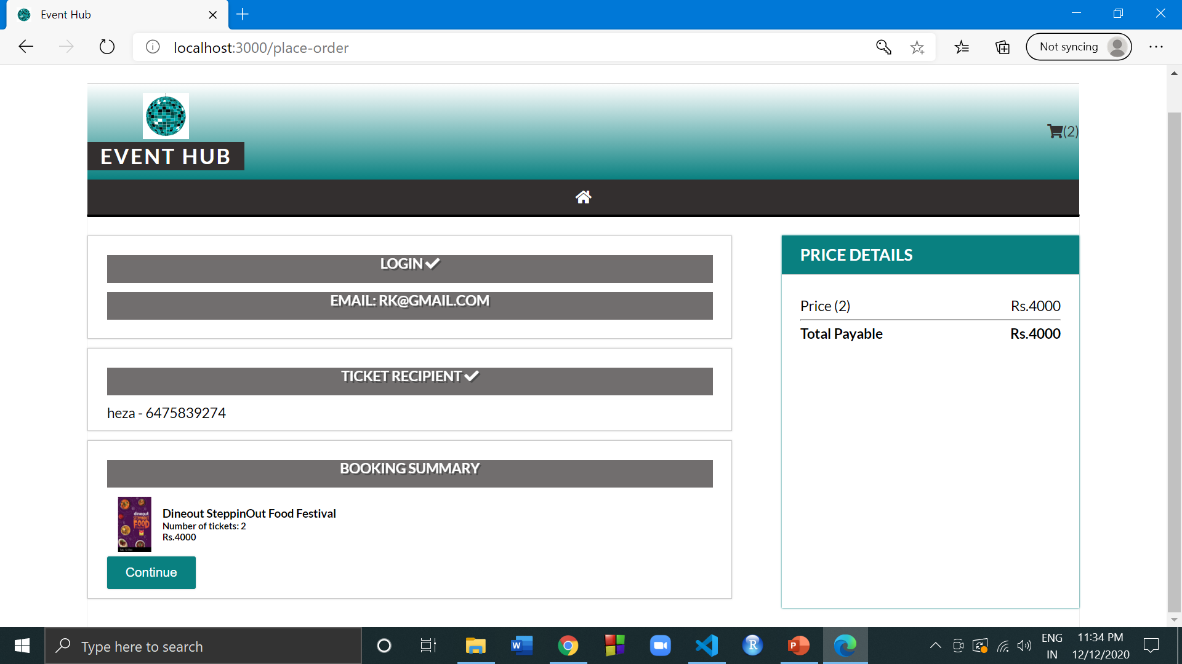
Booking summary

Slide 17
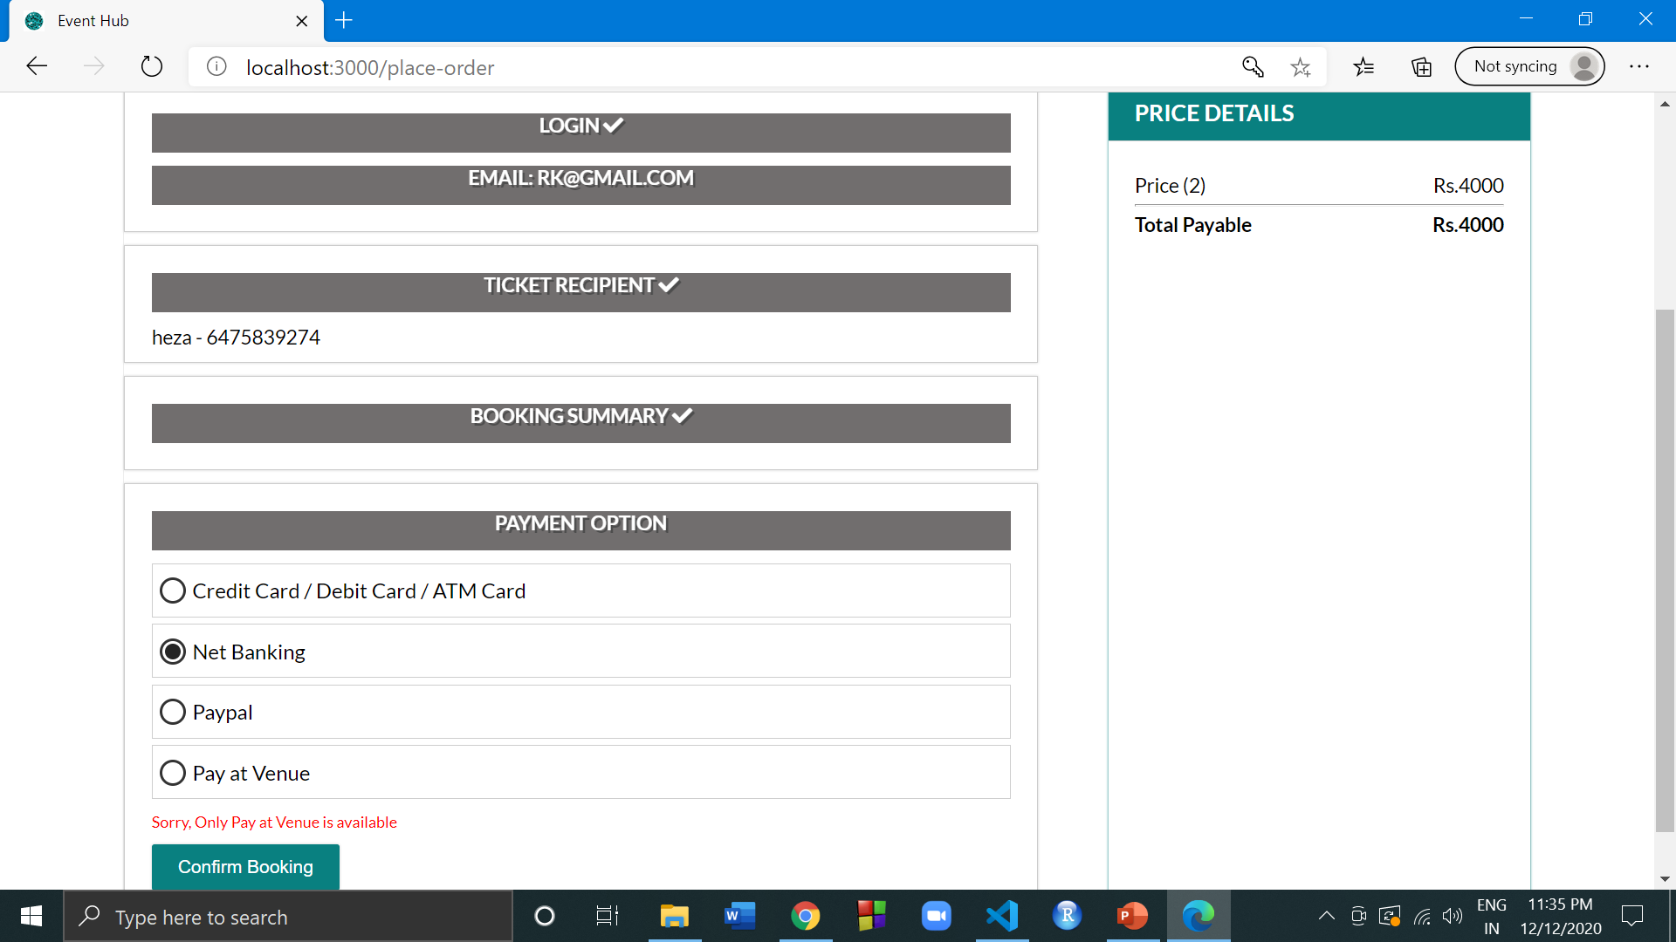
Payment options

Slide 18
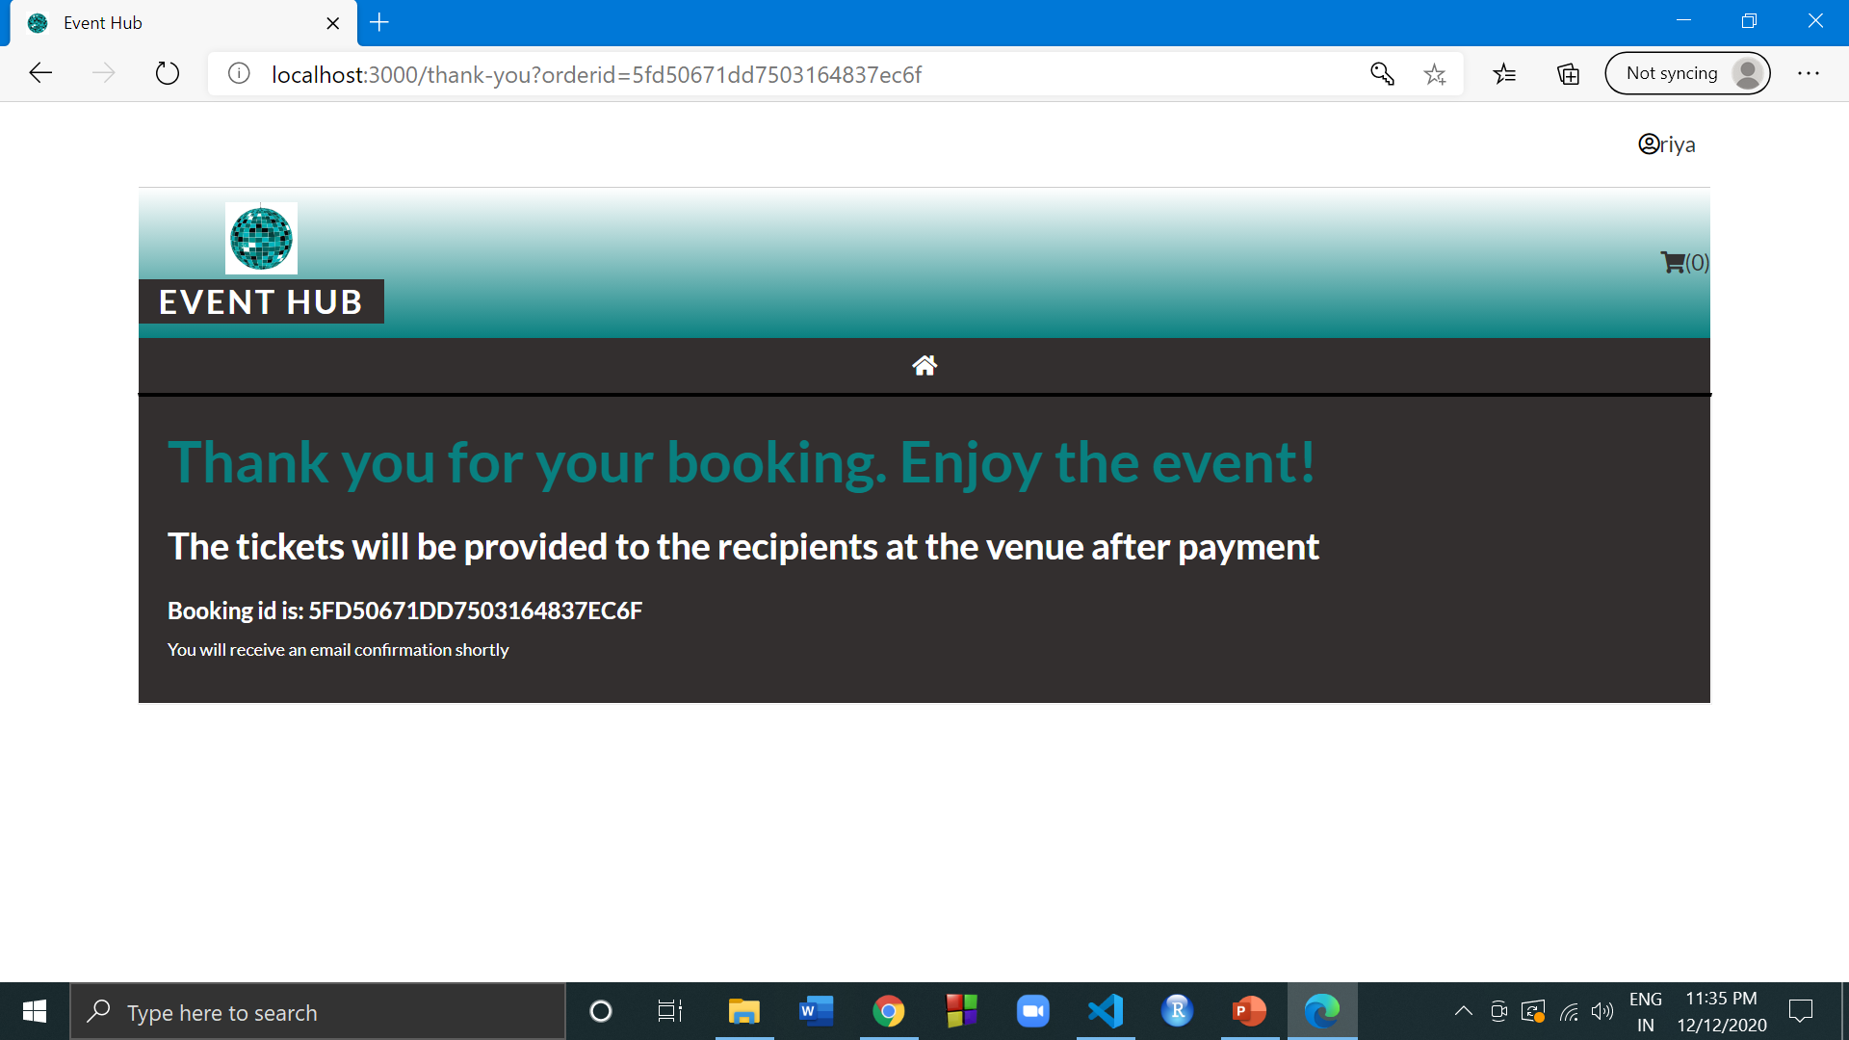
Booking confirmation page

Slide 19
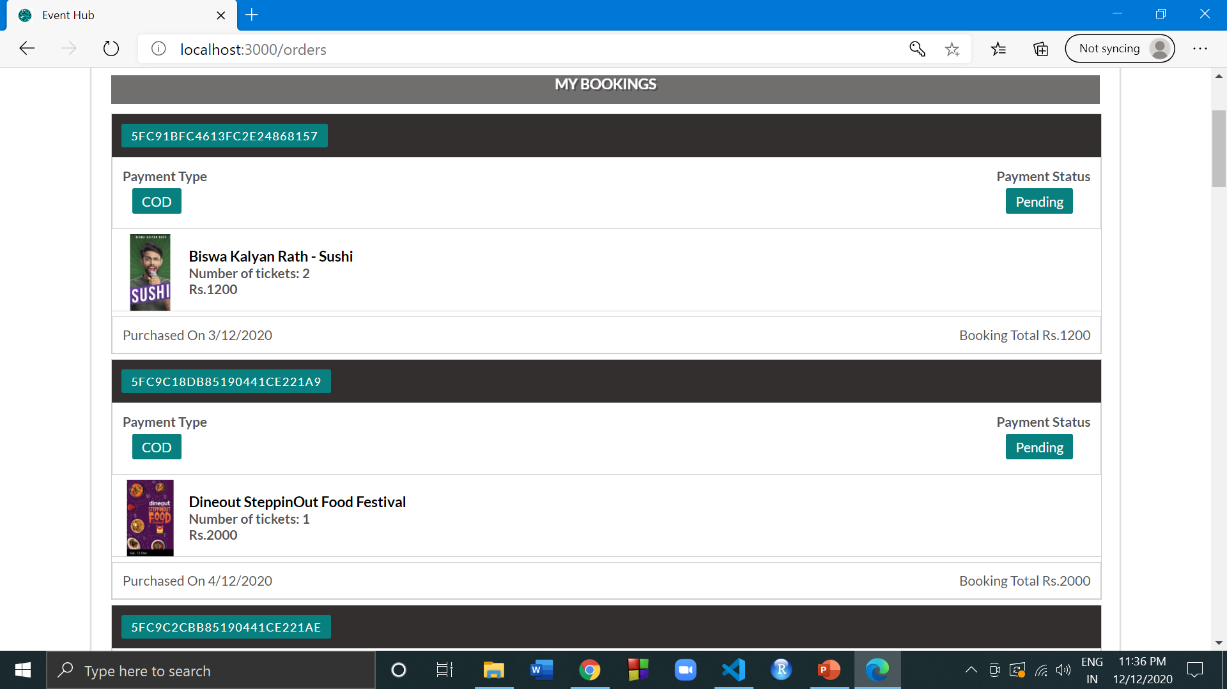
Previous orders page

Slide 20
Member Contributions
All three members worked on the entire website.
Prachi focussed on frontend and wrote html and styling of the website.
Nithin focussed on the backend routes and middleware
Raeesa worked on parts of both front end and backend by coding the react components and functions as well as the api, schema and helped with routes.
THANK YOU.

